Slide 2
DESIGNING , TESTING AND IMPLEMENTATION OF AUDIO STEGANOGRAPHY IN A NETWORK
SCHOOL OF COMPUTER SCIENCE
UNIVERSITY OF PETROLEUM & ENERGY STUDIES
Bidholi Campus, Energy Acres, Dehradun – 248007.
March - 2020
Under Guidance of
Dr. ADARSH KUMAR
Associate Professor
School of Computer Science, UPES, Dehradun

Slide 3
Submitted By:
Name | Enrollment Number | Role
Ayush Sharma | R134217045 | Coder Implementor
Mehul Aggarwal | R134217083 | Coder Designer
Ayush Sharma | 500061524 | R134217045 | Coder, Implementor | CSE-CSF Sem 6
Mehul Agrawal | 500060114 | R134217083 | Coder, Designer | CSE-CSF Sem 6

Slide 4
STEGANOGRAPHY
Steganography is data hidden within data. Steganography is an encryption technique that can be used along with cryptography as an extra-secure method in which to protect data.

Slide 5
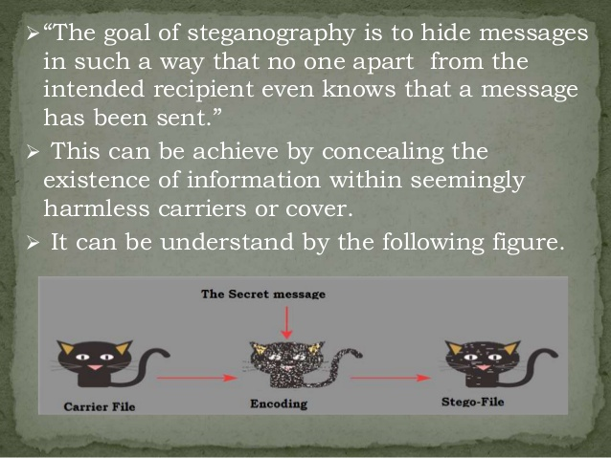
GOAL OF STEGANOGRAPHY
Whereas the goal of cryptography is to make data unreadable by a third party, the goal of steganography is to hide the data from a third party.

Slide 6
What Is Audio Steganography?
Information hiding technique is a new kind of secret communication technology. The majority of today’s information hiding systems uses multimedia objects like image, audio, video. Audio Steganography is a technique used to transmit hidden information by modifying an audio signal in an imperceptible manner. It is the science of hiding some secret text or audio information in a host message.

Slide 7
Why .wav format?
Wave is one of the most popular lossless compression format. Python has a native library called “wave” that provides us basic tools to manipulate audio data.

Slide 8
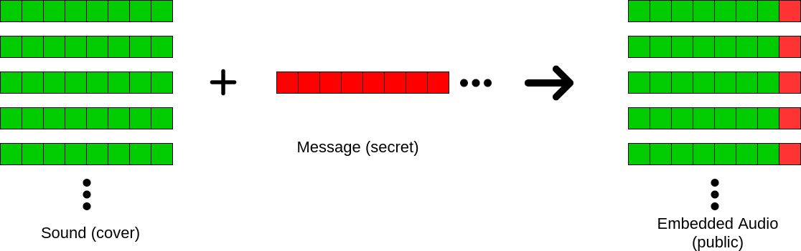
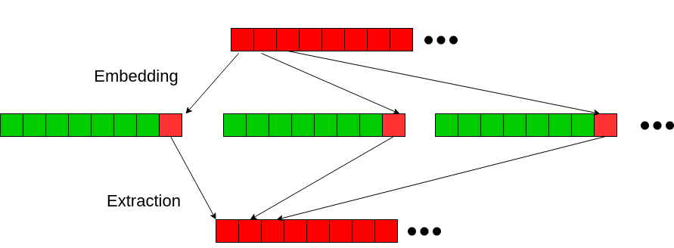
Working Of Audio Steganography (LSB Algorithm)

Slide 9
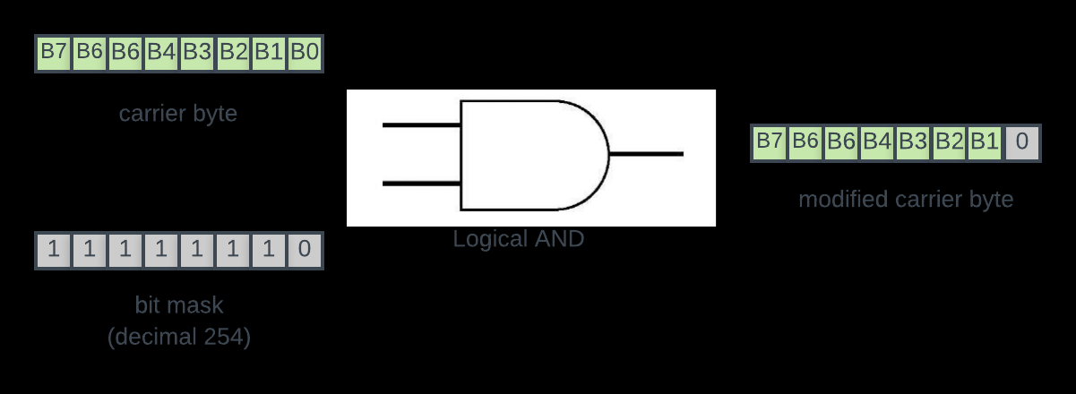
We will perform logical AND operation between each byte of carrier audio (the “song”) and a bit mask that resets the LSB of carrier byte.

Slide 10
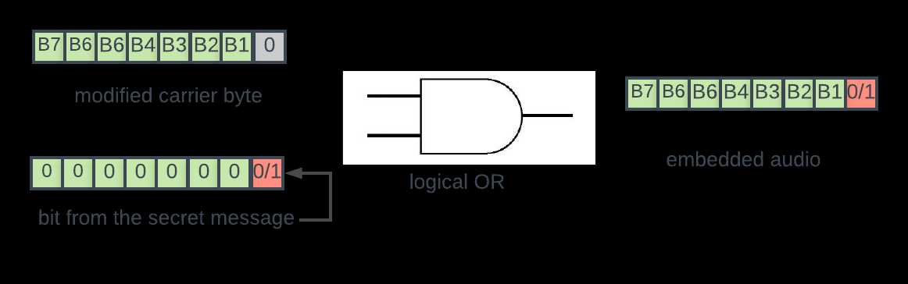
Then we will perform a simple logical OR operation between the modified carrier byte and the next bit (0 or 1) from the secret message.

Slide 11
Why LSB?
1. Low computational complexity.
2. Easy to implement.
3. Variation in choosing LSB.

Slide 12
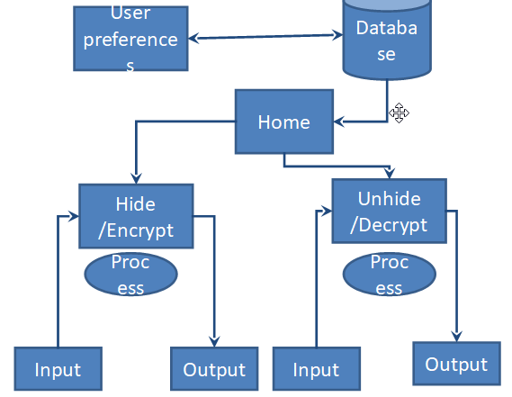
Data Flow Diagram

Slide 13
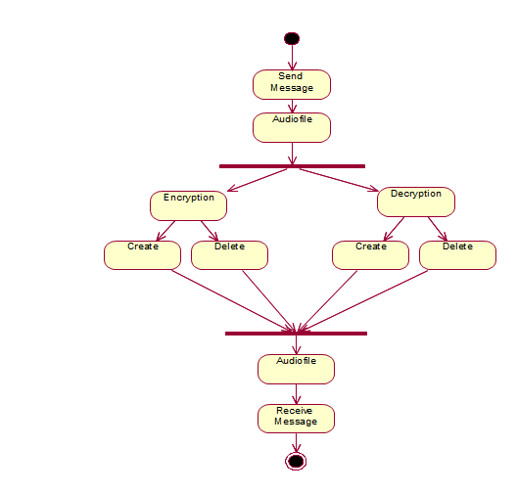
Use Case Diagram

Slide 14
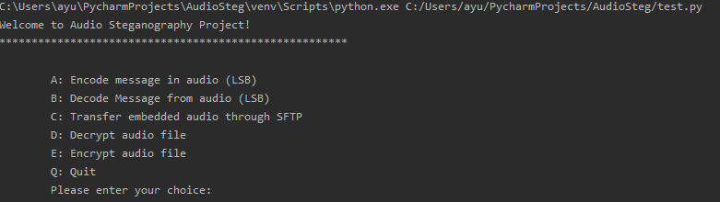
Main Menu

Slide 15
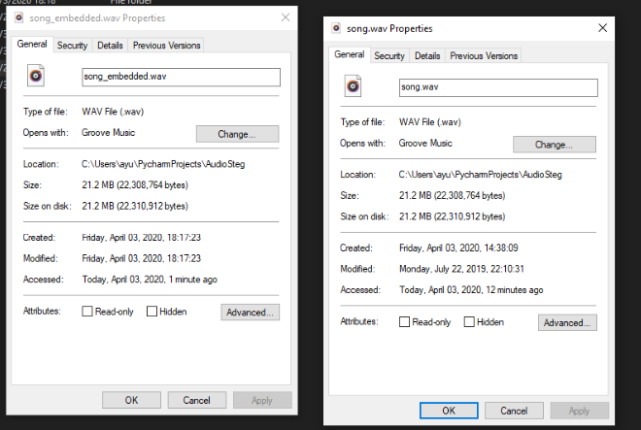
The size of original and encoded file is same.

Slide 16
The issue is how many bits can we alter and remain unnoticed?
In our project, we are altering only 1 and the encoded audio sounds similar.
Clearly seven bits would totally destroy the image and tip off the attackers. It's a balance between leveraging the unavoidable noise introduced by the audio digitisation process, the artistic scene and how dangerously you like to live.

Slide 17
AES Encryption Technique
Generate key and IV using random functions.
Open the file and read it. This will return bytes as the algorithm requires the data to be in the form of bytes.
Encrypt it using the encrypt function of the pycrypto library.
Write the encrypted bytes into a file.
Take the encrypted bytes data and pass it to the decrypt function
The resulting decrypted bytes data can be written to another file as a decrypted audio file.

Slide 18
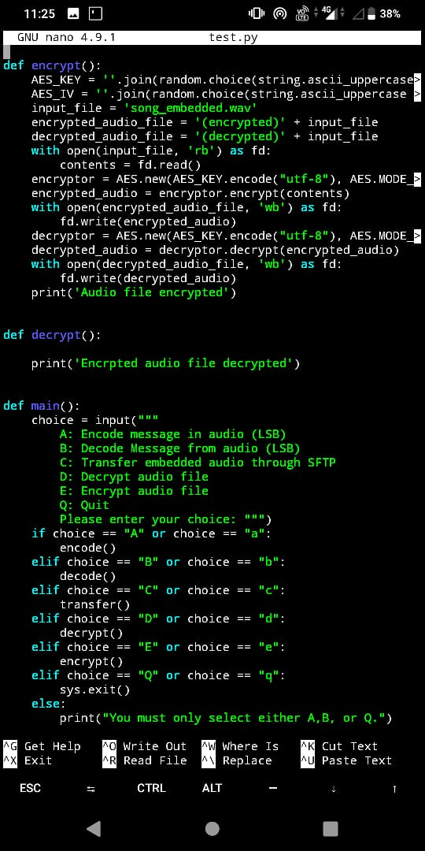
AES Encryption Technique

Slide 19
SFTP
SFTP stands for SSH file transfer protocol. While SFTP is a secure protocol for transferring files, the s stands for ssh or secure shell.

Slide 20
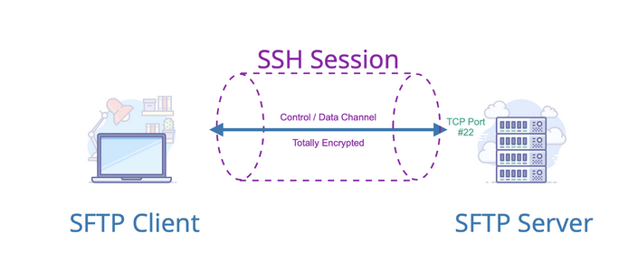
SFTP Diagram Illustration

Slide 21
SFTP vs FTP
So, how does encryption impact your choice between SFTP vs. FTP? The traditional file transfer protocol (FTP) is a simple way of transferring data, but it offers nothing in terms of data protection. Files are transferred without encryption, making data readable for anyone who intercepts it. While this is fine if you’re just sending unimportant files, this could lead to major data compromises if you’re sending crucial data.

Slide 22
SFTP vs FTP
SFTP, in contrast, offers a secure shell protecting files. Because files are encrypted, you don’t have to worry about data falling into the wrong hands. This is the ideal mode of transfer for any file that you want to protect. SFTP uses an encrypted type of fingerprint technology to first verify host keys before any data transfer has taken place.

Slide 23
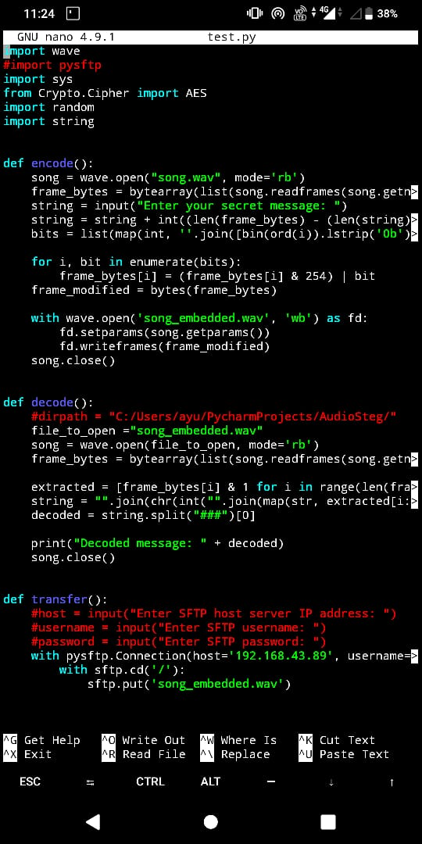
SFTP Code

Slide 24
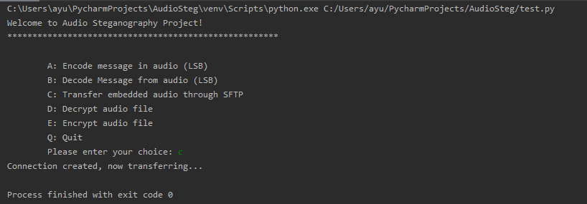
SFTP Finish

Slide 25
System Requirements
The minimum software requirement specifications for developing this project are as follows:
Operating System : Windows 10
Language : Python
Office Suite : Microsoft Office

Slide 26
System Requirements
The minimum hardware requirement specification for developing this project is as follows:
Processor : Intel i3
RAM : 8GB RAM
Hard Disk : 10GB

Slide 27
Application Of Audio Steganography
Audio steganography is applicable to, but not limited:
1) Confidential communication and secret data storing
2) Protection of data alteration
3) Access control system for digital content distribution
4) Media Database systems

